Slide 1

Lecture 2:
ORGANIZATIONAL STRUCTURE
AND DESIGN
By Alisher Ismailov
2023-2024 Academic Year

Slide 2

Agenda
Organizational Structure
Tall vs. Flat Organizations
Mechanistic vs. Organic Structures
Organizational Design
Work specialization
Departmentalization
Chain of command & span of control
(De)centralization
Formalization
Organizational Charts and Organigraphs
Organizational Environment and Structure

Slide 3
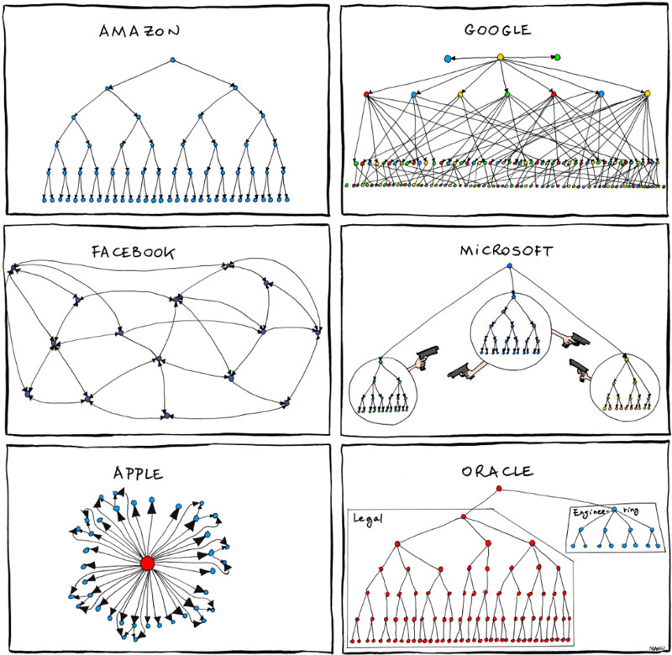
Organizational Structure
Definitions:
Formal arrangement of jobs within an organization
The specific working relationships among
people and their jobs to efficiently and
effectively achieve organizational purpose
A framework within which organization
arranges lines of authorities and
communications and allocates rights
and duties

Slide 4
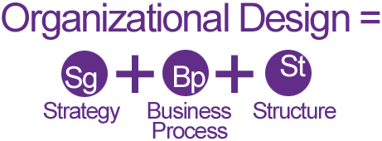
Organizational Design
The process of creating a structure that best fits a particular strategy and environment

Slide 5
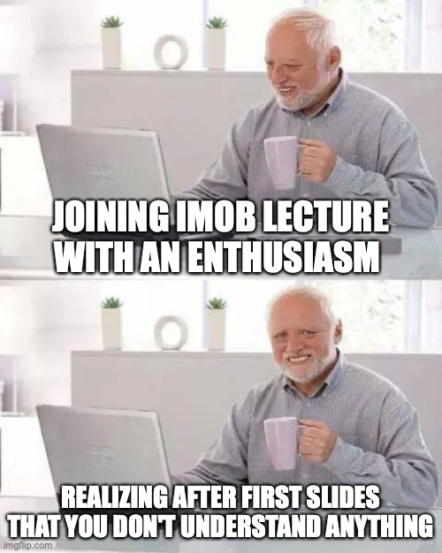

Slide 6
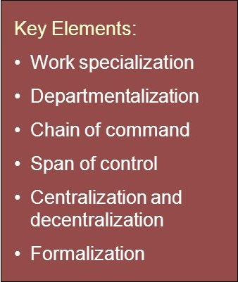
Organizational Design

Slide 7
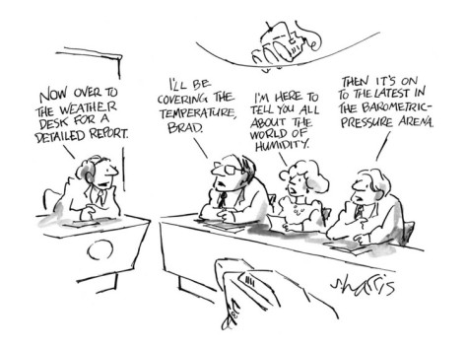
Work Specialization
The degree to which tasks in the organization are divided into separate jobs with each step completed by a different person
Overspecialization results in human diseconomies: boredom, fatigue, stress, poor quality, increased absenteeism, and higher turnover

Slide 8

Departmentalization
The organization of work groups according to some commonality

Slide 9
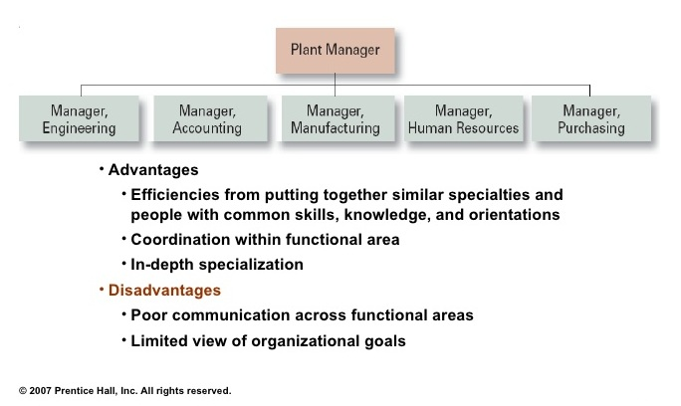
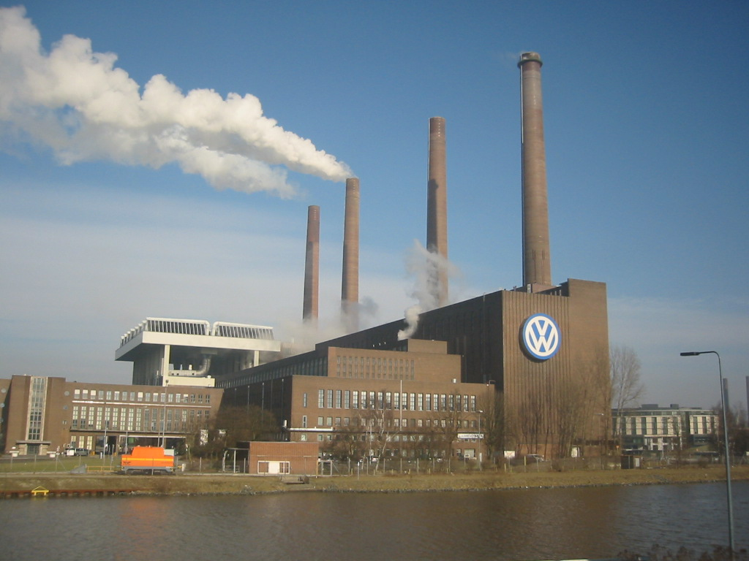
Functional Departmentalization

Slide 10
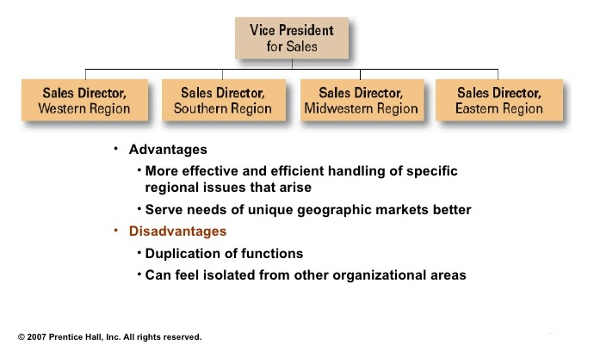
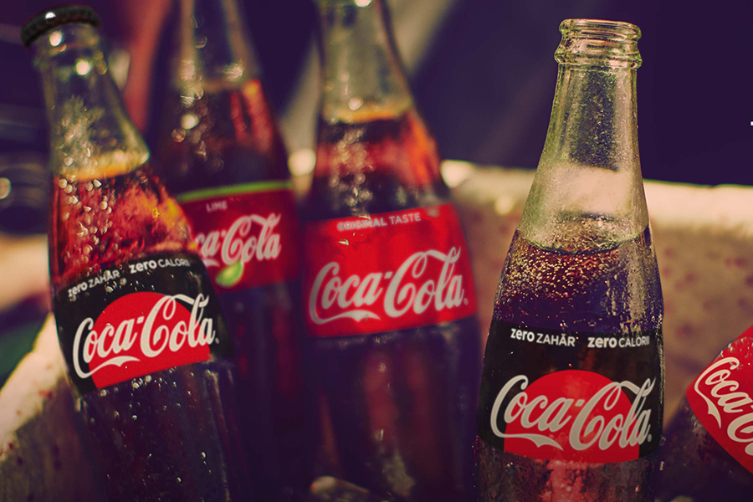
Geographic Departmentalization

Slide 11
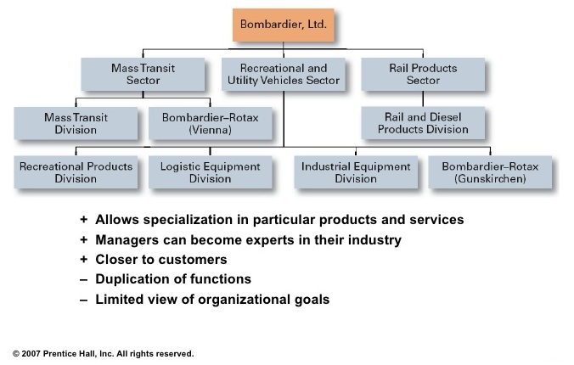

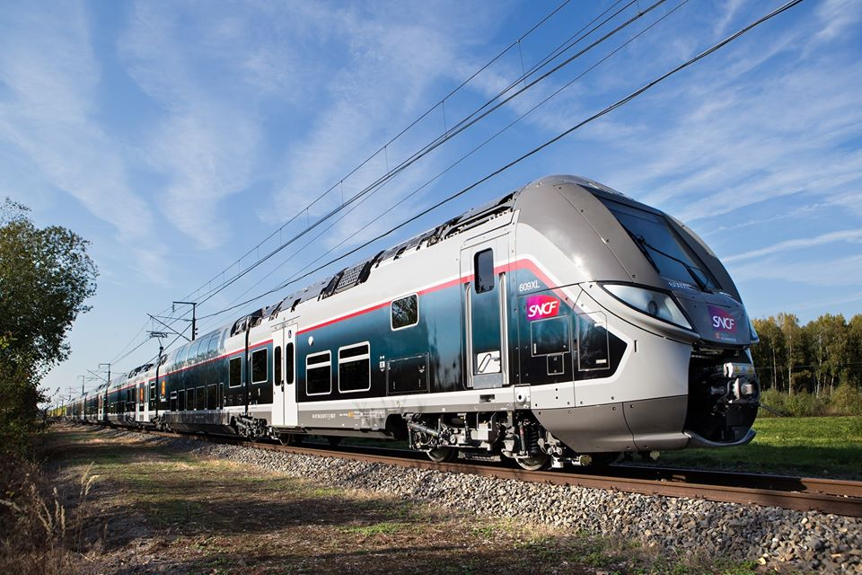
Product Departmentalization

Slide 12
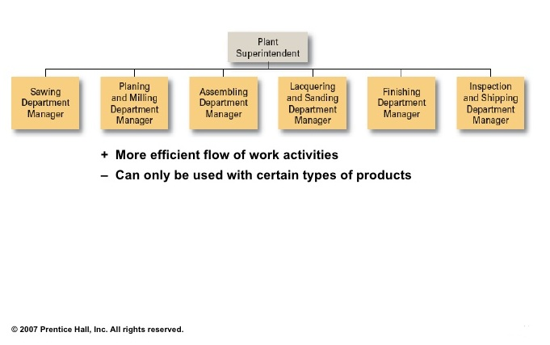
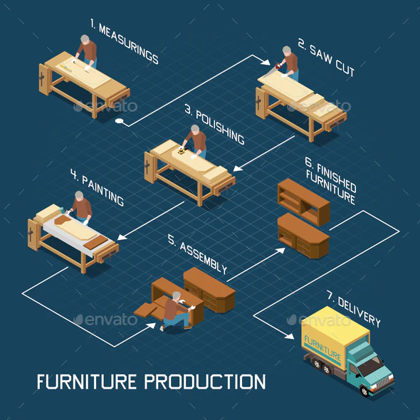

Process Departmentalization

Slide 13
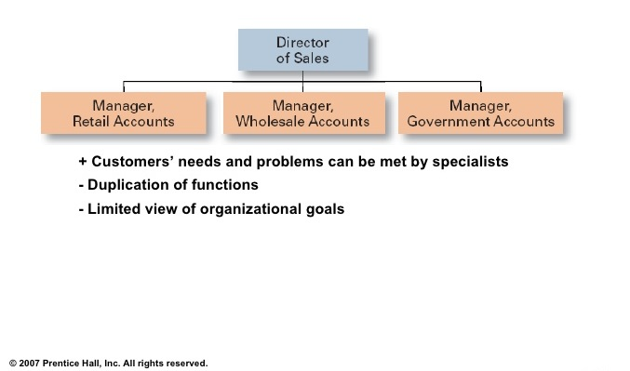
Customer Departmentalization

Slide 14
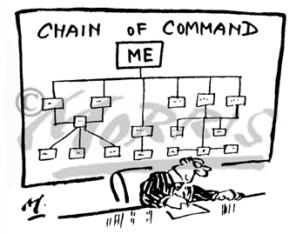
Chain of Command and Span of Control
Chain of Command - The hierarchical reporting relationships between superiors and subordinates
Span of Control – the number of people that report directly to a manager
Skills and abilities of manager
Employee characteristics
Characteristics of work
Similarity of tasks
Complexity of tasks
Physical proximity of subordinates
Standardization of tasks

Slide 15
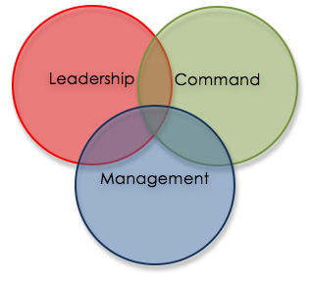
Chain of Command Glossary
Authority - The rights inherent in a managerial position to tell people what to do and to expect them to do it
Responsibility – The obligation of expectation to perform
Unity of Command – The concept that a person should have one boss and should report only to that person

Slide 16
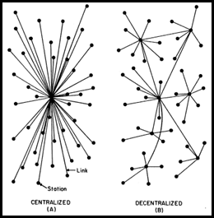
(De)Centralization

Slide 17

(De)Centralization
Centralization – Degree to which decision making is concentrated at a single point in the organizations
Top managers make all the decisions
Lower level employees simply follow orders
Decentralization – Decision making is pushed down to the managers who are closest to action
Employee Empowerment – Process of increasing decision making authority of employees

Slide 18
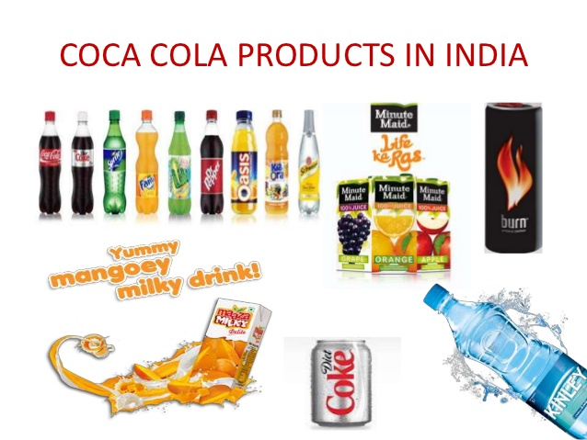
(De)Centralization
Coca-Cola decentralised its organisational structure by cutting half of the staff at its Atlanta headquarters and moving the regional chieftains closer to their local markets.
In India, decision making has been moved further down to different areas of that diverse country.

Slide 19
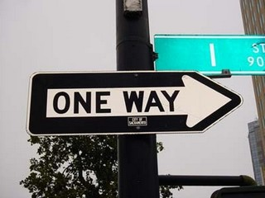
Formalization

Slide 20
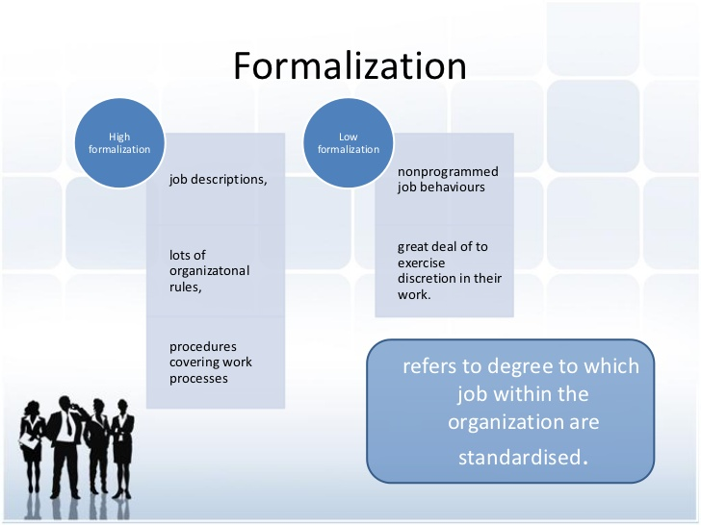
Formalization
Degree to which jobs in the organizations are standardized and the extent to which employee behavior is guided and limited by rules and procedures
High formalization little discretion
Low formalization fewer limitations

Slide 21
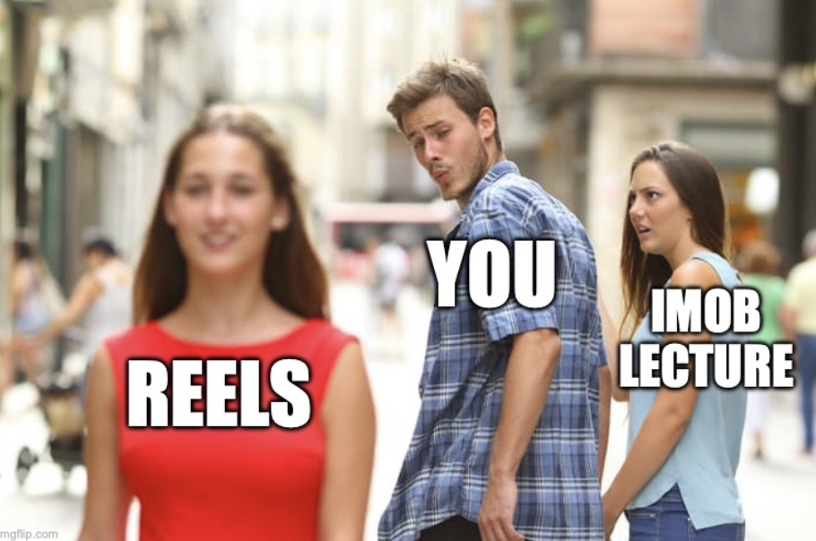

Slide 22
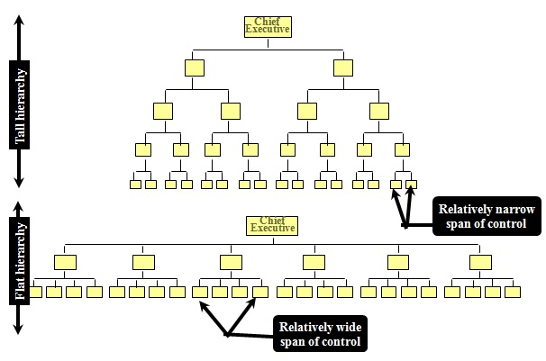
Tall vs. Flat
Tall organization – a structure in which managers have narrow span of control and therefore more levels in chain of command from top to bottom
Flat organization – a structure in which managers have wider spans of control and therefore fewer levels in the chain of command from top to bottom

Slide 23
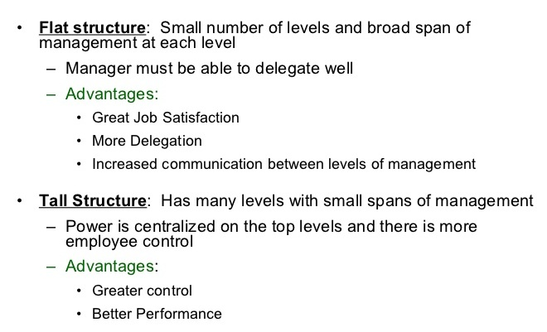
Pros and Cons

Slide 24
Mechanistic vs. Organic
Mechanistic (tall)
Organic (flat)
High formalisation
High specialization
Rigid departmentalization
Clear chain of command
Narrow span of control
High centralisation
Low formalisation
Cross hierarchical
Cross functional teams
Wide span of control
Free information flow
Low centralisation

Slide 25
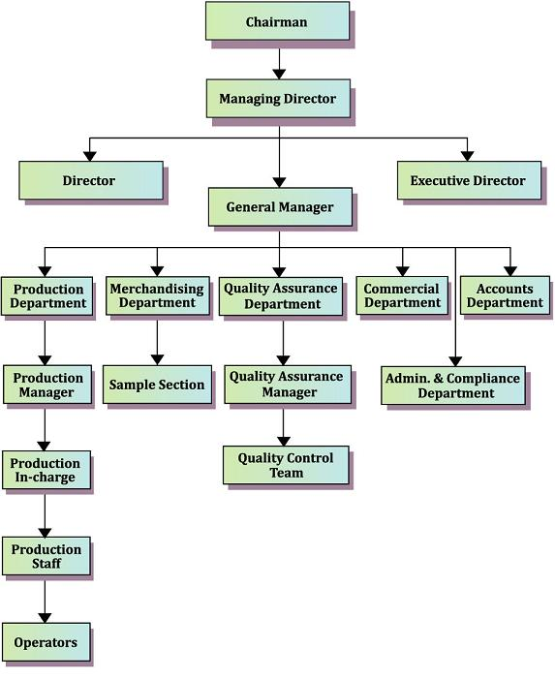
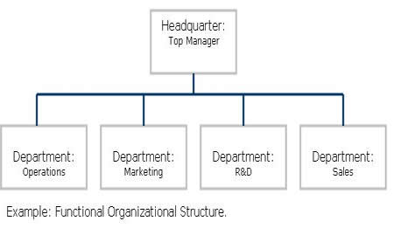
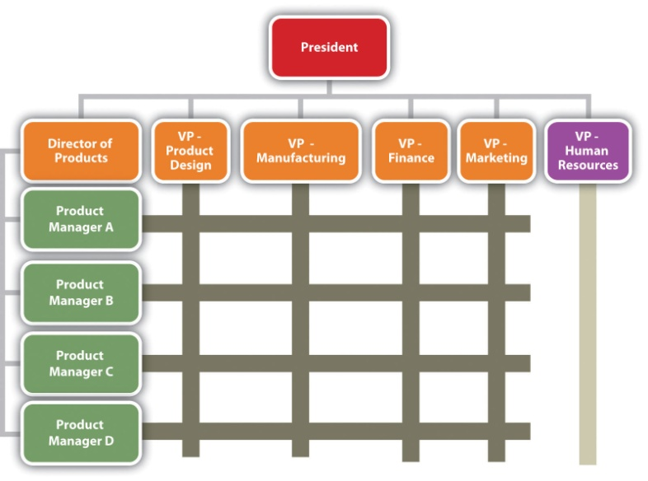
Organizational Chart
Organizational chart - is the most common visual depiction of how an organization is structured
Outlines the roles, responsibilities and relationships between individuals within an organization
Hierarchical Organizational Structure
Matrix Organizational Structure
Functional Organizational Structure

Slide 26
Reading
Montana, P. and Charnov, B. Management: A Streamlined Course for Students and Business People. (Hauppauge, New York: Barron’s Business Review Series, 1993), pp. 155-169.
Bounds, Gregory M, Gregory H Dobbins, and Oscar S Fowler. Management . A total quality perspective. Cincinnati, Ohio: South-Western College Pub., 1995. Print.
Schermerhorn, John R. Exploring Management. 3Rd Ed. Print
Mullins, L. (2002), Management and Organisational Behaviour, 6th edition, Harlow: Pearson Education Limited

Slide 27

PHEW…IT’S OVER!!!

